Slide 1
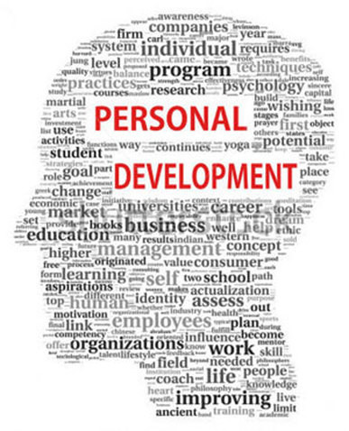
Personal Development Planning “The only journey is the journey within.”
Sanjeeva Perera
Senior Academic Fellow - Faculty of Computing

Slide 2

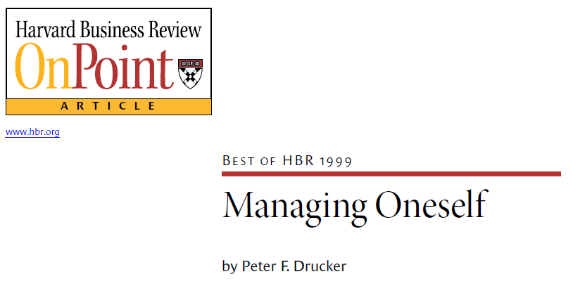
Lecture 1 - Personal Development Planning
Is the Process of Improving oneself Through Conscious habits and activities

Slide 3
In this Lecture you will learn:
Personal Development Planning
Stages in Personal Development
Five Core Aspects of Self-Awareness
Cognitive Style
Reflective Practice
Models of Reflective Practice
SWOT Analysis
Goal Setting / Planning

Slide 4
Assessment:
Mid term exam :
MCQ (40 Marks) Netexam
Final examination :
2 Hours Close book Net exam
Structured Questions (60 Marks)
Since Professional Skills is “The only journey is the journey within.”
Many self assessment test during the lecture Time

Slide 5
Personal Development Planning
Why we need PDP?
Industry is rapidly changing, if we don’t change/develop we will become obsolete
Taking personal responsibility over self development – It is our responsibility to develop ourselves
“The only journey is the journey within.”
Notes:
Area that lecturer is covering, You can see the text book,

Slide 6

Personal Development Planning
Video : The Rebirth of the Eagle Inspiring Story - Change for Survival
Notes:
Area that lecturer is covering, You can see the text book,

Slide 7
Personal Development Planning
PDP is a record of achievements, learning experiences and plans
It is prepared in order to recognise your achievements, understand how you gained your existing skills, plan to enhance them further and develop new ones
Notes:
Area that lecturer is covering, You can see the text book,

Slide 8
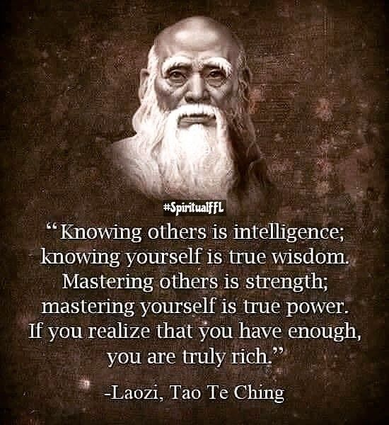
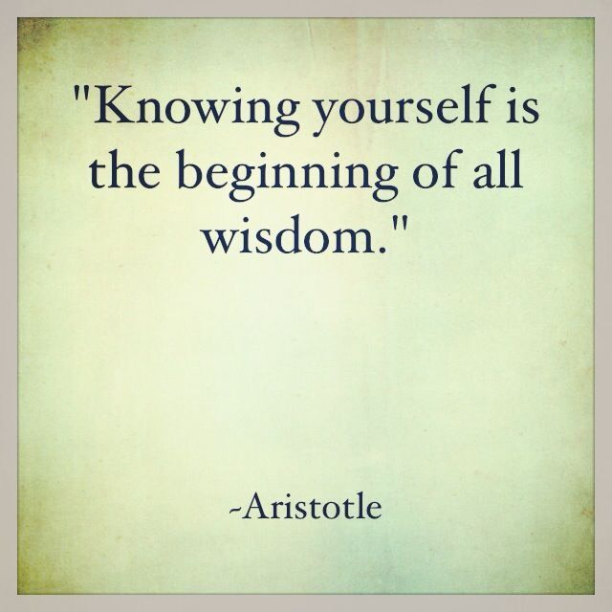
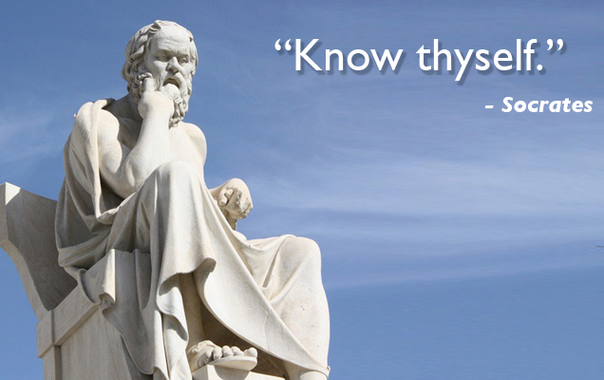
Personal Development Planning

Slide 9


Personal Development Planning
PDP is driven by:
Reflecting: how past skills are gained, reasons on successes and failures
Planning: how you are going to develop a certain skill that you want or need to face the future/to complete your degree, follow a specific career or achieve a personal goal
Notes:
Area that lecturer is covering, You can see the text book,

Slide 10
Personal Development Planning
It involves you building up a record of achievements, personal reflections and plans for self-improvement
The more you practise PDP, you are aware of your skills, the more developed they will become
the better your sense of personal achievement your focus on your goals/gaps
Notes:
Area that lecturer is covering, You can see the text book,

Slide 11
Stages in Personal Development
Understanding oneself (e.g. Identifying your skills, qualities, attributes and style)
Deciding where you want to be in the future
Deciding what you need to learn or change (the gap)
Identifying and applying methods of learning
Assessing your progress
Notes:
So, having established that PERSONAL DEVELOPMENT is a good thing, what process do you need to go through to achieve it?
STAGE ONE is understanding oneself and this is actually what we we’re focusing on this week. Using a variety of tools and self assessment techniques, by the end of the week you should have a better idea about your key characteristics, capabilities and preferences.
STAGE TWO is then identifying where you want to be in the future – what kind of position do you want to be in? What kind of organization? At What level of seniority? What kind of style would you like to have? What weaknesses do you want to overcome or preferences do you want to change?
STAGE THREE then involves looking at your conclusions from stage one and two and recognizing the gap between who you are at the moment and who you want to be in the future. You then need to identify the aspects of your personality or skill set that you want to change.
STAGE FOUR then involves identifying and applying appropriate methods of learning and
finally, in order to continue to develop and progress throughout your career, STAGE FIVE involves constantly assessing your progress.
And then the process starts again! It’s important to recognize that this isn’t a one off process, it’s something you should be striving to do throughout your career.

Slide 12
Stages in Personal Development
Understanding oneself (e.g. Identifying your skills, qualities, attributes and style)
Deciding where you want to be in the future
Deciding what you need to learn or change (the gap)
Identifying and applying methods of learning
Assessing your progress
Notes:
So, having established that PERSONAL DEVELOPMENT is a good thing, what process do you need to go through to achieve it?
STAGE ONE is understanding oneself and this is actually what we we’re focusing on this week. Using a variety of tools and self assessment techniques, by the end of the week you should have a better idea about your key characteristics, capabilities and preferences.
STAGE TWO is then identifying where you want to be in the future – what kind of position do you want to be in? What kind of organization? At What level of seniority? What kind of style would you like to have? What weaknesses do you want to overcome or preferences do you want to change?
STAGE THREE then involves looking at your conclusions from stage one and two and recognizing the gap between who you are at the moment and who you want to be in the future. You then need to identify the aspects of your personality or skill set that you want to change.
STAGE FOUR then involves identifying and applying appropriate methods of learning and
finally, in order to continue to develop and progress throughout your career, STAGE FIVE involves constantly assessing your progress.
And then the process starts again! It’s important to recognize that this isn’t a one off process, it’s something you should be striving to do throughout your career.

Slide 13

Understanding oneself (What is Self-Awareness ?)
Self-awareness is the ability to see yourself clearly and objectively through reflection and introspection (self examination).
Ref : Course web
Notes:
OK, so we’re going to spend some time today looking at various ways you can gain a deeper understanding of yourself.
Whetton and Cameron identify FIVE CORE aspects of self awareness.
CORE SELF EVALUATION captures the essential aspects of personality and we’ll look at a number of tools and theories that have been developed to explore this.
VALUES relates to your underlying personal standards and moral judgement and, in fact, recognizing your values, and those of others, is really important because values have been found to influence attitudes, preferences and behaviours.
COGNITIVE STYLE explores how individuals gather and process information and researchers have found that differences in cognitive style influence perception, learning, problem solving ability, decision making and creativity – all of which are important factors in Leadership and Management.
ATTITUDE TOWARDS CHANGE focuses on an individual’s ability to cope with change and deal with ambiguity and the methods that they use to achieve this.
And finally, EMOTIONAL INTELLIGENCE relates to emotional awareness and control and the ability to manage yourself and relationships with others. In fact emotinal intelligence has been found by researchers to be one of the most important factors in accounting for success in Leaders and Managers.
So, we’ll look at each of these in more detail now.

Slide 14
Self-Awareness – Study area of Social Science
What is difference between social sciences and physical sciences ?
Physical – inanimate (non-living) objects
SCIENCE
Biological – living things
Notes:
OK, so we’re going to spend some time today looking at various ways you can gain a deeper understanding of yourself.
Whetton and Cameron identify FIVE CORE aspects of self awareness.
CORE SELF EVALUATION captures the essential aspects of personality and we’ll look at a number of tools and theories that have been developed to explore this.
VALUES relates to your underlying personal standards and moral judgement and, in fact, recognizing your values, and those of others, is really important because values have been found to influence attitudes, preferences and behaviours.
COGNITIVE STYLE explores how individuals gather and process information and researchers have found that differences in cognitive style influence perception, learning, problem solving ability, decision making and creativity – all of which are important factors in Leadership and Management.
ATTITUDE TOWARDS CHANGE focuses on an individual’s ability to cope with change and deal with ambiguity and the methods that they use to achieve this.
And finally, EMOTIONAL INTELLIGENCE relates to emotional awareness and control and the ability to manage yourself and relationships with others. In fact emotinal intelligence has been found by researchers to be one of the most important factors in accounting for success in Leaders and Managers.
So, we’ll look at each of these in more detail now.

Slide 15
Self-Awareness – Study area of Social Science
What is difference between social sciences and physical sciences ?
Science - All matter, living and non-living, is composed of the same basic ingredients- atoms and molecules
Cleary, however, human behavior cannot be understood on the basis of either physical or biological science alone
Notes:
OK, so we’re going to spend some time today looking at various ways you can gain a deeper understanding of yourself.
Whetton and Cameron identify FIVE CORE aspects of self awareness.
CORE SELF EVALUATION captures the essential aspects of personality and we’ll look at a number of tools and theories that have been developed to explore this.
VALUES relates to your underlying personal standards and moral judgement and, in fact, recognizing your values, and those of others, is really important because values have been found to influence attitudes, preferences and behaviours.
COGNITIVE STYLE explores how individuals gather and process information and researchers have found that differences in cognitive style influence perception, learning, problem solving ability, decision making and creativity – all of which are important factors in Leadership and Management.
ATTITUDE TOWARDS CHANGE focuses on an individual’s ability to cope with change and deal with ambiguity and the methods that they use to achieve this.
And finally, EMOTIONAL INTELLIGENCE relates to emotional awareness and control and the ability to manage yourself and relationships with others. In fact emotinal intelligence has been found by researchers to be one of the most important factors in accounting for success in Leaders and Managers.
So, we’ll look at each of these in more detail now.

Slide 16
Self-Awareness – Study area of Social Science
What is difference between social sciences and physical sciences ?
Examples
Sociology
Psychology
Political science
Economics
Social Science
is the discipline that investigates
the interrelationships among people
Notes:
OK, so we’re going to spend some time today looking at various ways you can gain a deeper understanding of yourself.
Whetton and Cameron identify FIVE CORE aspects of self awareness.
CORE SELF EVALUATION captures the essential aspects of personality and we’ll look at a number of tools and theories that have been developed to explore this.
VALUES relates to your underlying personal standards and moral judgement and, in fact, recognizing your values, and those of others, is really important because values have been found to influence attitudes, preferences and behaviours.
COGNITIVE STYLE explores how individuals gather and process information and researchers have found that differences in cognitive style influence perception, learning, problem solving ability, decision making and creativity – all of which are important factors in Leadership and Management.
ATTITUDE TOWARDS CHANGE focuses on an individual’s ability to cope with change and deal with ambiguity and the methods that they use to achieve this.
And finally, EMOTIONAL INTELLIGENCE relates to emotional awareness and control and the ability to manage yourself and relationships with others. In fact emotinal intelligence has been found by researchers to be one of the most important factors in accounting for success in Leaders and Managers.
So, we’ll look at each of these in more detail now.

Slide 17
Five Core Aspects of Self-Awareness
Core Self-evaluation
Underlying personality
Values
Personal standards and moral judgment
Cognitive Style
Information acquisition and evaluation
Attitudes towards Change
Adaptability and responsibility
Emotional Intelligence
Emotional and awareness and control
Discuss in next lectures …..
Notes:
OK, so we’re going to spend some time today looking at various ways you can gain a deeper understanding of yourself.
Whetton and Cameron identify FIVE CORE aspects of self awareness.
CORE SELF EVALUATION captures the essential aspects of personality and we’ll look at a number of tools and theories that have been developed to explore this.
VALUES relates to your underlying personal standards and moral judgement and, in fact, recognizing your values, and those of others, is really important because values have been found to influence attitudes, preferences and behaviours.
COGNITIVE STYLE explores how individuals gather and process information and researchers have found that differences in cognitive style influence perception, learning, problem solving ability, decision making and creativity – all of which are important factors in Leadership and Management.
ATTITUDE TOWARDS CHANGE focuses on an individual’s ability to cope with change and deal with ambiguity and the methods that they use to achieve this.
And finally, EMOTIONAL INTELLIGENCE relates to emotional awareness and control and the ability to manage yourself and relationships with others. In fact emotinal intelligence has been found by researchers to be one of the most important factors in accounting for success in Leaders and Managers.
So, we’ll look at each of these in more detail now.

Slide 18
Five Core Aspects of Self-Awareness
Core Self-evaluation
Underlying personality
Values
Personal standards and moral judgment
Cognitive Style --------→ Lecture 2
Information acquisition and evaluation
Attitudes towards Change
Adaptability and responsibility
Emotional Intelligence
Emotional and awareness and control
Notes:
OK, so we’re going to spend some time today looking at various ways you can gain a deeper understanding of yourself.
Whetton and Cameron identify FIVE CORE aspects of self awareness.
CORE SELF EVALUATION captures the essential aspects of personality and we’ll look at a number of tools and theories that have been developed to explore this.
VALUES relates to your underlying personal standards and moral judgement and, in fact, recognizing your values, and those of others, is really important because values have been found to influence attitudes, preferences and behaviours.
COGNITIVE STYLE explores how individuals gather and process information and researchers have found that differences in cognitive style influence perception, learning, problem solving ability, decision making and creativity – all of which are important factors in Leadership and Management.
ATTITUDE TOWARDS CHANGE focuses on an individual’s ability to cope with change and deal with ambiguity and the methods that they use to achieve this.
And finally, EMOTIONAL INTELLIGENCE relates to emotional awareness and control and the ability to manage yourself and relationships with others. In fact emotinal intelligence has been found by researchers to be one of the most important factors in accounting for success in Leaders and Managers.
So, we’ll look at each of these in more detail now.

Slide 19
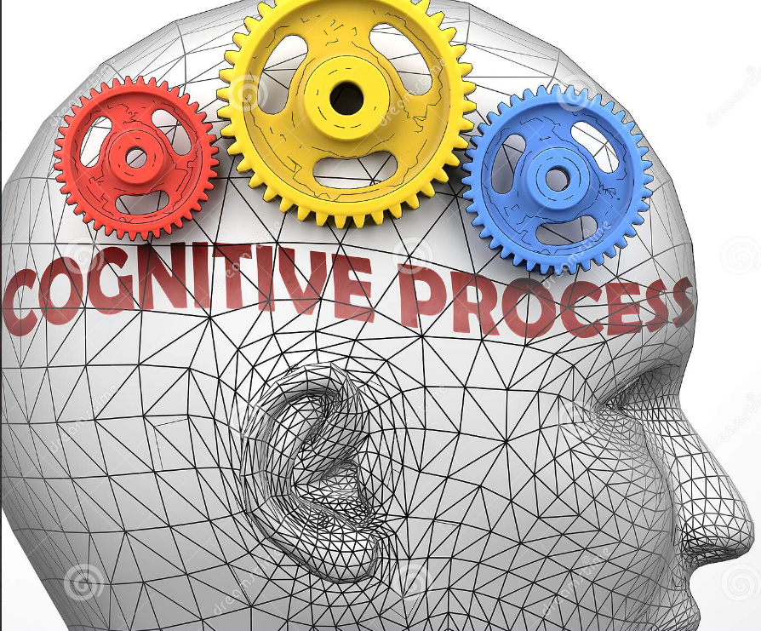
Cognitive Style Information acquisition and evaluation
Cognitive comes from the Latin cognito, meaning to Apprehend or understand Cognition- A general term including all mental processes by which people become aware of and understand the world. (This explain why people are different)
Comprehensively discuss in Lecture 2 : with individual student evaluations on core aspects
Notes:
OK, so we’re going to spend some time today looking at various ways you can gain a deeper understanding of yourself.
Whetton and Cameron identify FIVE CORE aspects of self awareness.
CORE SELF EVALUATION captures the essential aspects of personality and we’ll look at a number of tools and theories that have been developed to explore this.
VALUES relates to your underlying personal standards and moral judgement and, in fact, recognizing your values, and those of others, is really important because values have been found to influence attitudes, preferences and behaviours.
COGNITIVE STYLE explores how individuals gather and process information and researchers have found that differences in cognitive style influence perception, learning, problem solving ability, decision making and creativity – all of which are important factors in Leadership and Management.
ATTITUDE TOWARDS CHANGE focuses on an individual’s ability to cope with change and deal with ambiguity and the methods that they use to achieve this.
And finally, EMOTIONAL INTELLIGENCE relates to emotional awareness and control and the ability to manage yourself and relationships with others. In fact emotinal intelligence has been found by researchers to be one of the most important factors in accounting for success in Leaders and Managers.
So, we’ll look at each of these in more detail now.

Slide 20
Reflective Practice
In order to learn effectively it is not enough to simply have an experience
In order to maximise the learning potential of the situation before it is lost, we need to reflect on the experience
Reflecting is an important stage of the PDP process
You need to reflect in order to improve and develop your skills and knowledge; the idea is that you learn from your successes and mistakes
Notes:
Planning has to be reviewed, daily, weekly and annually. Drawbacks should be identified and rectified.

Slide 21
Reflection and Reflective Practice
Reflection is the purposive, deliberate revisiting of an experience, to explore and extract the learning offered by the experience.
Reflection promotes deep learning in personal and professional development and improvement of practice.

Slide 22
Reflective Practice
Individual learners capacity to engage with an experience.
Reflect critically on it.
Deduce the lessons learnt that need to be applied to future activity.

Slide 23
Reflection and Reflective Practice
Approaches to Learning
Surface Learning | Deep Learning
Intention to complete the task and memorize information. | Intention to understand and seek meaning.
 | Attempt to relate concepts to existing experience.
No distinction between new ideas and existing knowledge. | Distinguish between new ideas and existing knowledge
 | Critical evaluation of events.
Facts learned out with a meaningful framework. | Facts learned in the context of meaning.
Knowledge | Understanding

Slide 24
Attendance

Slide 25
Reflection and Reflective Practice
Achievement of Expertise
Level 1 - Novice stage
Adherence to taught rules, little discretionary judgment.
Level 2 - Advanced Beginner
All aspects and attributes are given equal importance.
Level 3 - Competent Practitioner
Able to perform routine procedures.
Level 4 – Proficient Practitioner
Can differentiate between different aspects and situations.
Level 5 – Expert Practitioner
Has deep, implicit and unconscious understanding.

Slide 26
Models of Reflective Practice
Gibbs Model
Peters DATA model

Slide 27
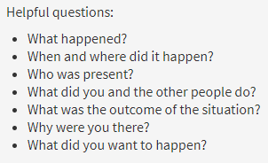
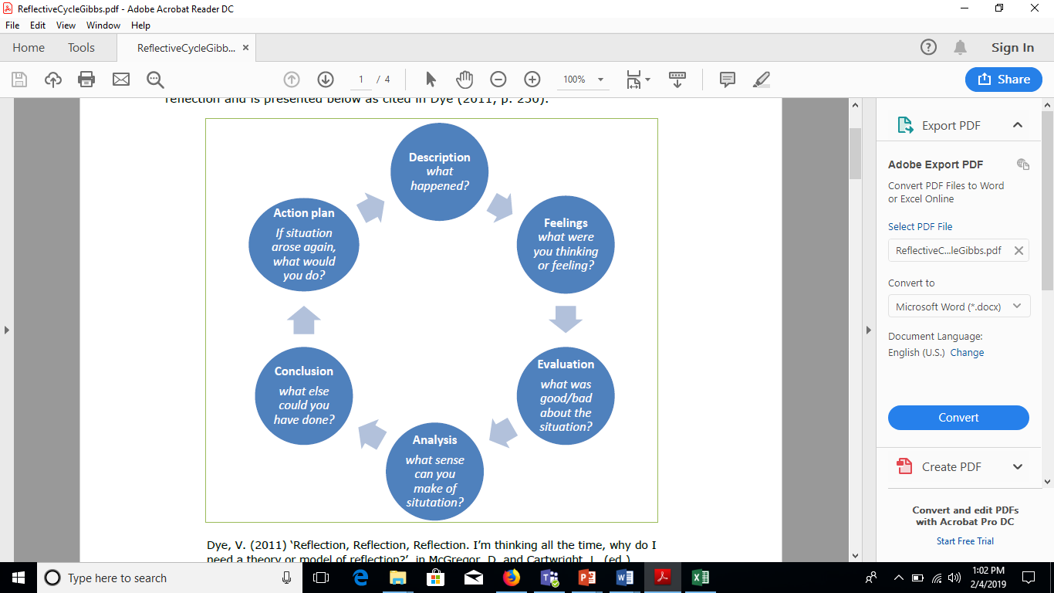
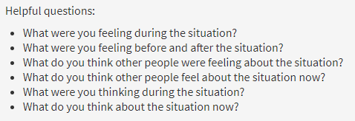
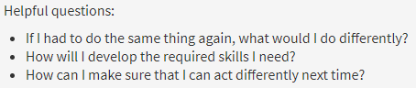
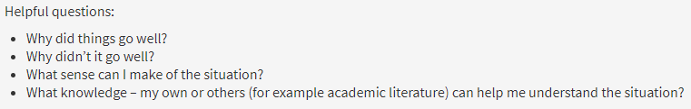
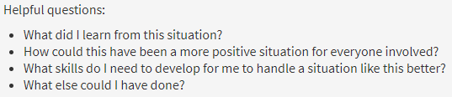
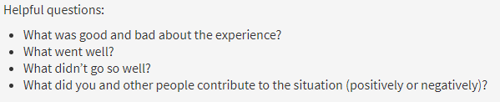
Gibb’s Reflective Cycle
https://www.ed.ac.uk/reflection/reflectors-toolkit/reflecting-on-experience/gibbs-reflective-cycle

Slide 28
The DATA Model
DESCRIBE
The area of practice which you feel needs improvement or change
ANALYSE
The factors contributing to the problem area of practice.
THEORISE
Possible ways to improve the practice, and suggest ways forward
ACT
On your theory, by trying out the new practice to see how it works

Slide 29

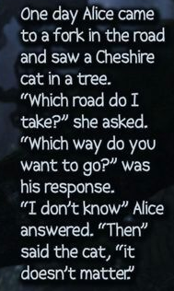

Slide 30
Personal Development Plan
In professional world this is called as professional development plan
Starts with a goal or a gap analysis
Ex: Goal Setting:
Want to get A+ for SE
Improve Body Mass Index (BMI) from 28 to 25 (Gap 3 units)
Note : Your BMI, which stands for body mass index, is a measure of body fat in relation to your height and weight.
Prepare a strategic plan to achieve your target
Use SWOT Analysis
SW Internal Factors, OT External Factors
SO Favourable (Helps you to achieve your goals)
WT Unfavourable (Blocks your progress)

Slide 31
Example : Software Company Technology Stack & Competency Matrix

Slide 32

Senior Full Stack Software Engineer (.Net)
About the job
The Software Engineer is a technical member of the development team. They are responsible for designing, coding, and reviewing the work done in the team. They participate in all aspects of the agile software development lifecycle, from inception to support. Software Engineers embrace continuous personal improvement in their own learning process and team improvement. Software Engineers demonstrate competence in technical decision making and problem solving. They independently manage their contributions and proactively raise impediments. They fully understand the processes and support adoption by the team. Software Engineers are a positive influence on the culture of the team and help other team members meet their objectives.

Slide 33
Senior Full Stack Software Engineer (.Net)
Essential Duties & Responsibilities
Contributes independently to multiple functional and technical areas within a product.
Designs and scopes new features.
Creates artifacts/documents that are valuable to the team.
Continued ownership of technical growth including:
Product and business knowledge
Problem solving skills
Technical knowledge
Process knowledge
Acts as a good citizen within the team technically and culturally.
Ensures quality of code written or reviewed.
Adheres to quality/technical team standards.

Slide 34
Senior Full Stack Software Engineer (.Net)
Essential Duties & Responsibilities
Reviews code according to their expertise.
Ensures that their deliverables meet the scheduled commitments.
Makes decisions in their area of responsibility that help maintainability, reuse, and performance.
Initiates conversations to get the support/clarity necessary to carry out a task.
Constructively challenges existing perspectives and proposed solutions inside the team.
Proactively assists in accomplishing team-level technical goals.
Initiates knowledge sharing with other team members.
Evaluates alignment of work with strategic initiatives and company goals.
Able to diagnose issues and provide solutions for multiple functional and technical areas within a product.
Can independently frame problems and perform relevant research for small (1 team-sprint) effort.

Slide 35
Senior Full Stack Software Engineer (.Net)
Skillset
Required
Front-end technology: Expertise in front-end technologies, including JavaScript / Typescript, CSS3 and HTML5 and third-party libraries such as Angular.
Development languages: Knowledge of server-side programming languages including C# /.Net,
Database and cache: Familiarity with DBMS technology, including SQL Server
Web Services: Experience with SOAP, REST, JSON.
Good writing and communication skills
Ability to visualize a proposed system and be able to build it.
Preferred
Dev Ops: Comfortable to use DevOps environment(Ex: Ansible, Terraform)

Slide 36
SWOT Analysis
A SWOT Analysis is a tool for identifying your Strengths and Weaknesses, and for examining the Opportunities and Threats to your goals
SWOT Analysis helps you to focus your activities into areas where you are strong and where the greatest opportunities lie
Notes:
Planning has to be reviewed, daily, weekly and annually. Drawbacks should be identified and rectified.

Slide 37
SWOT Analysis
What skills or experience do you already possess? Give examples to evidence these if you can.
What do you do well?
What do other people see as being your strengths? Consider this from your own point of view and from the point of view of the people who know you. Don't be modest - be realistic.
If you are having any difficulty with this, try writing down a list of your characteristics. Some of these will probably be strengths.
Strengths
Notes:
Planning has to be reviewed, daily, weekly and annually. Drawbacks should be identified and rectified.

Slide 38
SWOT Analysis
What could you improve on?
What do you do badly?
What should you avoid?
Do other people consider you to have weaknesses that you do not agree with? Why do they think that? Do you see weaknesses in yourself that others do not see as being a problem?
Weaknesses
Notes:
Planning has to be reviewed, daily, weekly and annually. Drawbacks should be identified and rectified.

Slide 39
SWOT Analysis
What resources are available to you?
Consider the networking opportunities that will be available to you. How will you make best use of these?
What are the interesting trends you are aware of in the graduate employment market?
How can you develop yourself according to these?
Are there any other learning opportunities, in addition to those offered by your degree programme, that you are interested in exploring?
Opportunities
Notes:
A useful approach to looking at opportunities is to look at your strengths and ask yourself whether these open up any
opportunities. Alternatively, look at your weaknesses and ask whether you could find opportunities to eliminate them.

Slide 40
SWOT Analysis
What obstacles do you face?
Could any of your weaknesses seriously threaten your opportunities? What are they?
Do you have past experience of trying and failing to achieve your goals?
Threats
Notes:
Planning has to be reviewed, daily, weekly and annually. Drawbacks should be identified and rectified.

Slide 41
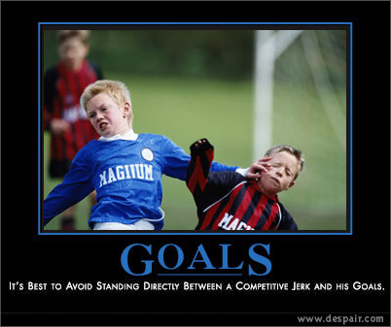
Goal Setting (Plan)

Slide 42

Solid Goal Characteristics
S – Specific
M – Measurable
A – Achievable
R – Result – based
T – Time specific

Slide 43
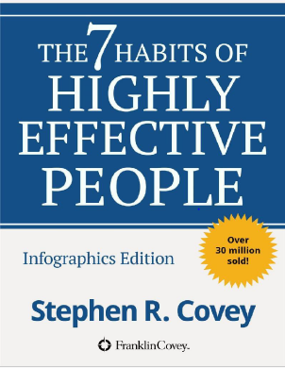
Leaders are Readers
The 7 Habits of Highly Effective People Stephen R Covey (2004)
“#2 Begin with the End in Mind”

Slide 44
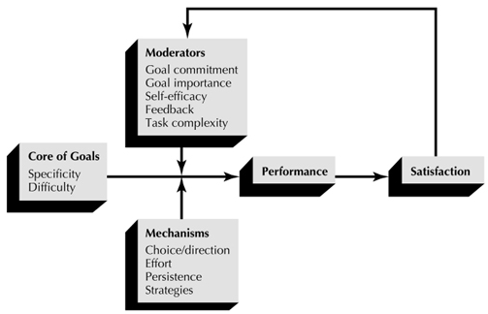
Model for Relating Goals to Performance and Satisfaction (Locky and Latham model)

Slide 45
PDP
Exercise
Set a goal or understand a gap in your skills
Do a SWOT by keeping that goal/gap in mind
Write down Plan strategies to achieve the goal/gap

Slide 46
Final Words
Form a habit of doing this regularly when you see a gap in your skills
Or
When you set a target for life

Slide 47
Questions ?

